Slide 1
Pedagogy How are we going about advanced course
Pre-work
Read related research papers
Read related articles
Watch related videos
During class
Explain concept and Math
Implement toy example from scratch
Implement example in one of the framework
Discuss assignment related to current dataset/problem
Post class
Implement learnings on a real data set from current problem sets
Upload evaluation and findings on the leader board
Top scorer does KS

Slide 2
Pre-Work Complete below pre-work prior to the session
Good understand of following components of neural networks
Forward propagation
Loss function
Gradient Descent
Backpropagation

Slide 3
RNN with Tensorflow
Set up T4 Machine – 15 min
RNN Architecture – 30 min
Implementation in Tensorflow – Part 1 – 1 hour
Break – 10 min
Implementation in Tensorflow – Part 2 – 1 hour
Assignment – 15 min

Slide 4
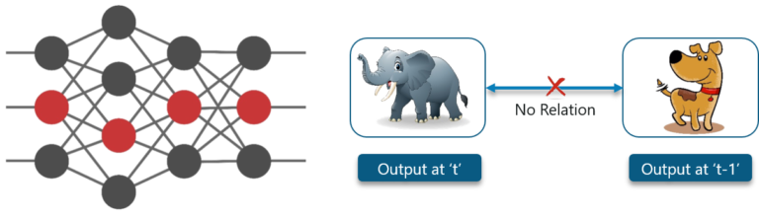
Why Not Feed-forward Networks? Works when output at time ‘t’ is independent of output at time ‘t-1’

Slide 5
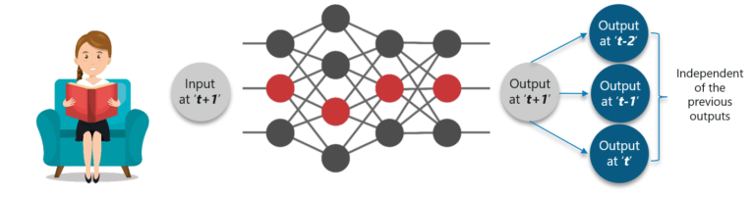
Why RNN When outputs are dependent on previous outputs

Slide 6
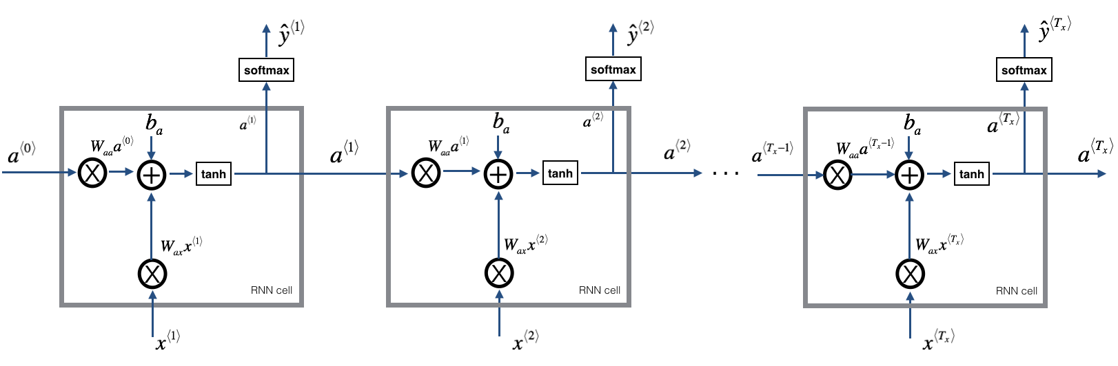
RNN Forward propagation for the basic Recurrent Neural Network

Slide 7
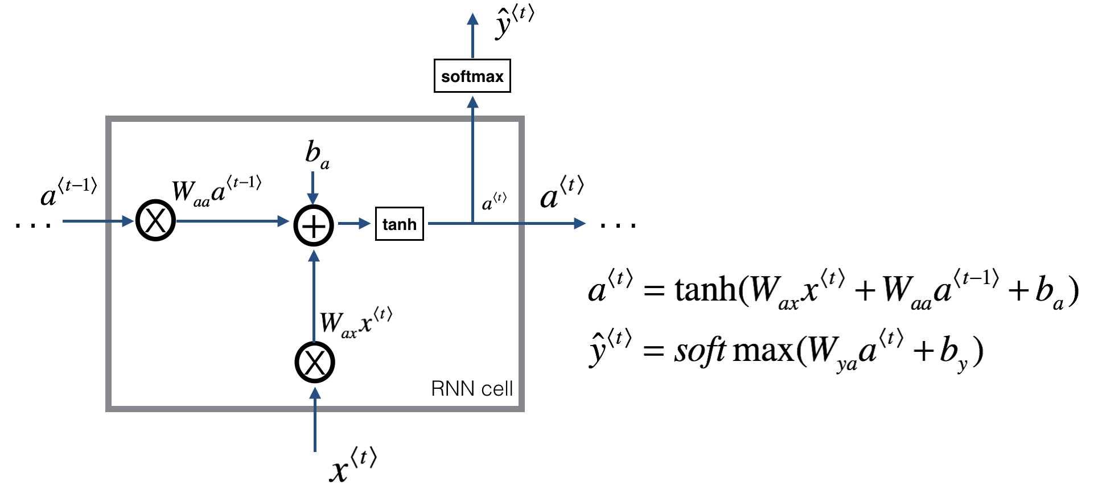
RNN Cell Operations for a single time-step of an RNN cell
x^{<t>} -- your input data at timestep "t“
a^{<t-1>} -- Hidden state at timestep "t-1“
W_{aa} -- Weight matrix multiplying the hidden state
W_{ax} -- Weight matrix multiplying the input
b_{a} -- Bias
W_{ya} -- Weight matrix relating hidden-state to output
b_{y} -- Bias relating the hidden-state to the output
a^{<t>} -- next hidden state
Y^{<t>} -- prediction at timestep "t"

Slide 8
Neural Network What is NN and components

Slide 9
Word Embeddings You are known by the company you keep

Slide 10
NLP - Downstream tasks 347 leader boards • 205 tasks • 100 datasets • 2605 papers with code
Refer to paperswithcode.com to see the list of all NLP tasks and respective papers with leader board
Question Answering
Language Modelling
Sentiment Analysis
Text Classification
Named Entity Recognition
Sentence Embeddings
Tokenization

Slide 11
Resources and references
https://towardsdatascience.com/recurrent-neural-networks-rnns-3f06d7653a85 - Original post
http://joshvarty.github.io/VisualizingRNNs/ - Visualize RNN working here
https://www.tensorflow.org/tutorials/text/text_generation - TF2 example with RNN GRU
https://medium.com/@erikhallstrm/hello-world-rnn-83cd7105b767
Theory
https://medium.com/learn-love-ai/introduction-to-recurrent-neural-networks-rnns-43238d037a5c
https://medium.com/x8-the-ai-community/building-a-recurrent-neural-network-from-scratch-f7e94251cc80

Slide 12
Assignment
Due date 6th March
Implement RNN to predict next words that HCP can write while searching for product information

